Slide 1
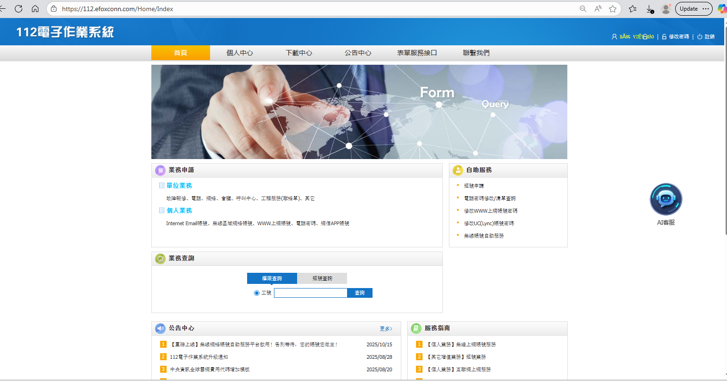
Vào web 112

Slide 2
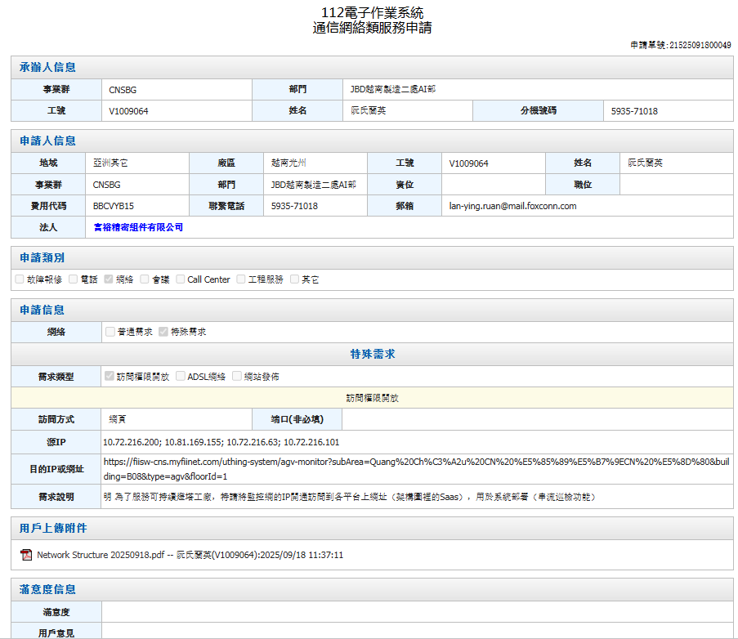
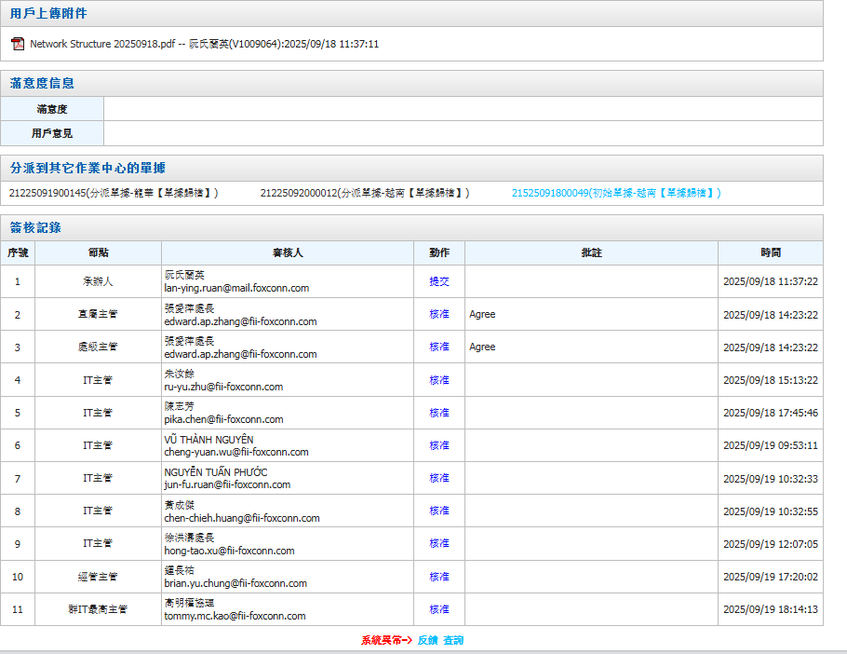
Làm đơn theo mẫu chị Lan Anh

Slide 3
Info
STT | ID Card | Email
1 | F1337979 | edward.ap.zhang@fii-foxconn.com
2 | G6000576 | ru-yu.zhu@fii-foxconn.com
3 | 832945 | pika.chen@fii-foxconn.com
4 | V1061480 | cheng-yuan.wu@fii-foxconn.com
5 | V1079136 | jun-fu.ruan@fii-foxconn.com
6 | 021987 | CHEN-CHIEH.HUANG@FII-FOXCONN.COM
7 | F1338240 | hong-tao.xu@fii-foxconn.com
8 | 812810 | brian.yu.chung@fii-foxconn.com
9 | 016290 | tommy.mc.kao@fii-foxconn.com

